Slide 1

DATA ANALYST INTERNSHIP • TASK 4
Dashboard Design
Supermart Grocery Sales Dashboard
Designing an interactive retail analytics solution for executive stakeholders.
PRIMARY TOOL
DATASET DOMAIN
Microsoft Power BI
Supermart Retail Analytics

Slide 2



PROJECT OBJECTIVE
Empowering Business Stakeholders
"Design an interactive dashboard for business stakeholders."
Transforming raw retail sales records into actionable business intelligence for strategic decision-making.
Financial Oversight
Segment Drill-Down
Self-Service Analytics
Tracks overall sales revenue, profitability metrics, and order growth rates instantly.
Analyzes performance across product categories, sub-categories, and regional markets.
Enables custom slicing by region and category for personalized business exploration.

Slide 3
DATA FOUNDATION
Supermart Grocery Sales Dataset
Selected Retail Analytics financial dataset powering the Power BI dashboard model.
Transaction Identifiers
Order ID and Customer tracking for transactional granularity.
Schema Columns
Order ID
Customer
Category
Sub Category
City
Categorical Hierarchy
Multi-level product grouping by Category and Sub-Category.
State
Region
Order Date
Sales
Discount
Profit
Financial & Geographic Measures
Sales, Profit, and Discount metrics aggregated across Region, State, and City.

Slide 4
CORE METRICS
Power BI KPI Cards
High-level summary indicators designed for quick executive assessment.
TOTAL SALES
TOTAL PROFIT
TOTAL ORDERS
SALES GROWTH
Revenue
Earnings
Volume
% Growth
Overall gross turnover
Net business profitability
Transaction frequency count
Period-over-period trend
KPI cards provide a concise summary of key business metrics, allowing decision-makers to evaluate business performance instantly without searching through raw tables.

Slide 5

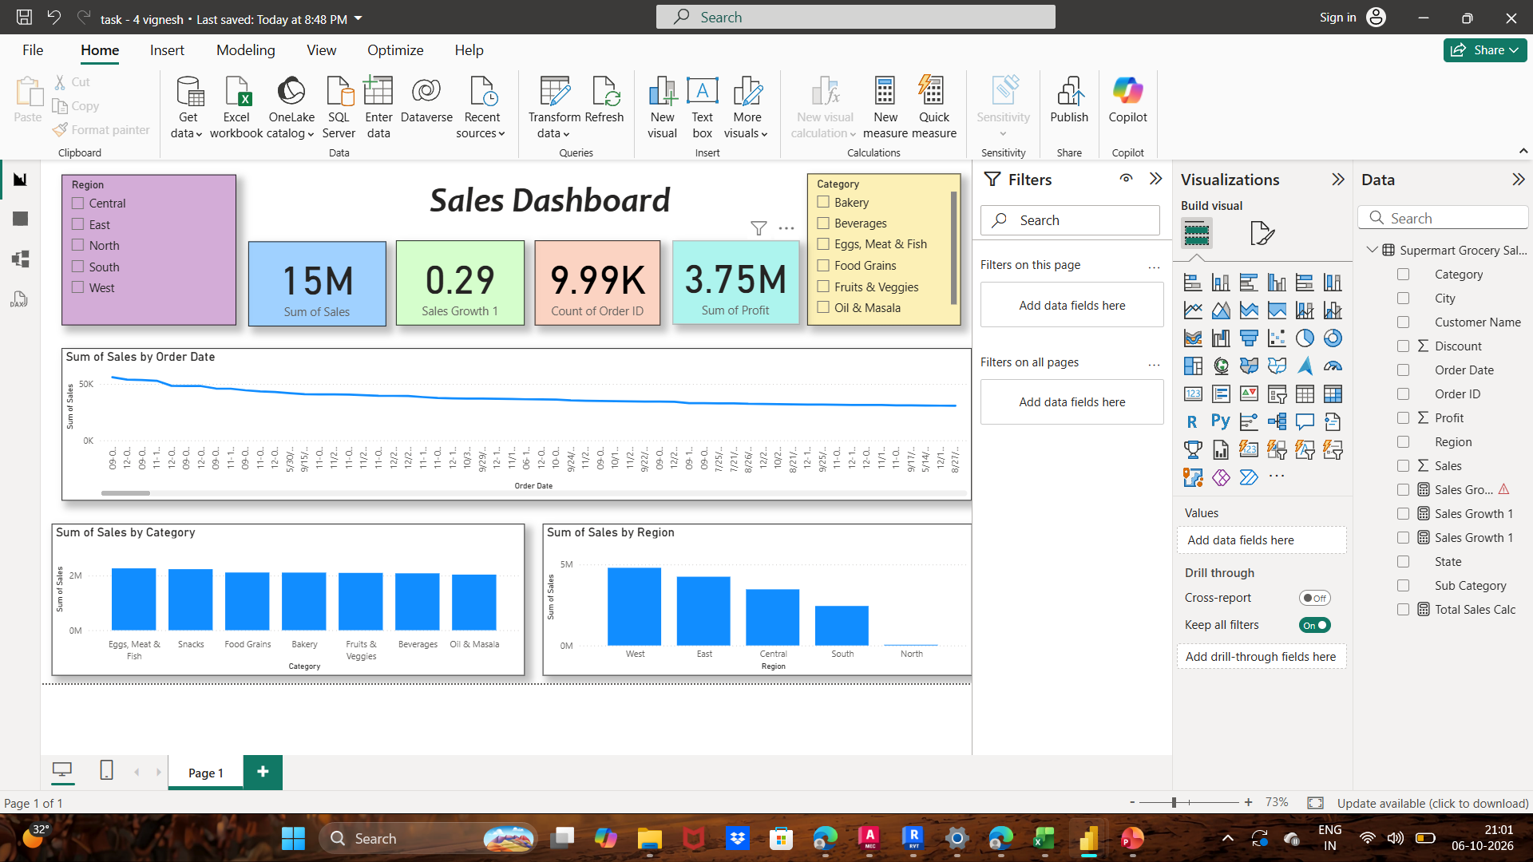
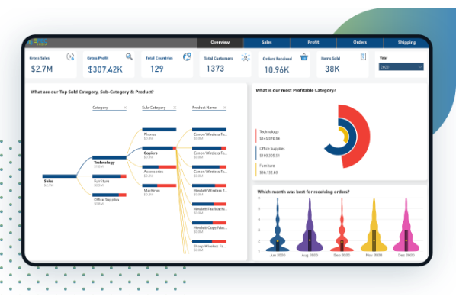
VISUAL ARCHITECTURE
Power BI Dashboard Layout & Interactivity
Sales Trend Over Time
Line chart analyzing time-series sales growth across months and quarters.
Sales by Category & Region
Column charts comparing product category revenue and regional performance.
Interactive Slicers
Category and Region slicers enable dynamic, real-time visual filtering.
Executive KPI Cards
Top-level summary blocks displaying instant aggregated figures.

Slide 6
PROJECT WRAP-UP
Learning Outcomes & Interview Guide
Key Learning Outcomes
Task 4 Interview Questions Reference
Interactive Dashboard: Built end-to-end Power BI report.
1. Key Elements: KPI Cards, Charts (Line/Column), Slicers, Titles.
KPI Cards: Summarized Sales, Profit, Orders, & Growth.
2. What is a KPI? Key Performance Indicator measuring strategic metrics.
Dynamic Slicers: Applied Category & Region filtering.
3. What are Slicers? Visual filters allowing users to slice dataset views.
Trend Analysis: Utilized line charts for time-series.
4. Power BI vs Tableau: Power BI integrates deeply with Microsoft/DAX.
5. Making Interactive: Use cross-filtering, slicers, and drill-throughs.
Column Charts: Evaluated comparative category sales.
6. Large Datasets: Optimize Star Schema, DAX, & DirectQuery/Aggregations.
Professional Design: Maintained clean visual layout.
7. Trend Charts: Line charts and Area charts for temporal patterns.

